Slide 1
INDIAN KNOWLEDGE SYSTEM (IKS)
By this term, we mean the indigenous sources of knowledge generated by the Indian society
current political formation called India is of a recent origin and it alone does not qualify to be "India." The term India points to the Undivided Indian subcontinent (AKHANDA BHARATA).We mean the geographical area spanning from Burma on the east to modern day Afghanistan in the west and Himalayas in the north to the Indian ocean in the south. This region has common cultural, literary and social practices and has witnessed continuous exchange of people and ideas x them throughout the history of undivided India. Despite several political formations and princely states ruling this entire region for last several hundred years until consolidation begun from 16h century CE, the society was unified under the common umbrella of social practices. Chanakya could get educated in Taxila in the western part of subcontinent and be instrumental in establishing a powerful Mauryan empire with Pataliputra as the capital the Eastern part. Similarly Panini as Sanskrit Grammarian from Gandhara .The North Western corner (now in Pakistan)could influence the thinking of people in the entire country on Sanskrit language.

Slide 2
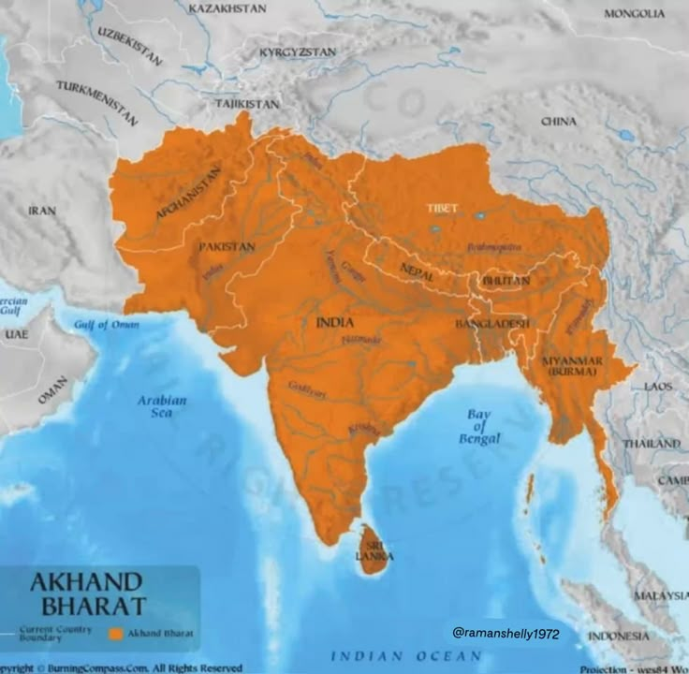
India’s Map
A second aspect to this is only such knowledge synthesized, codified, and made available by the ' Indians' is considered Indian Knowledge. This implies that they ought to have been part of the Indian subcontinent, Those born and/or lived for a substantial amount of time, fully integrating with the native culture and practices.

Slide 3
KNOWLEDGE
The second component of IKS is the . knowledge` which is always tacit. It is obtained by the insights gained by personal experiences with life situations, facing problems and coming up with means of solving them. At other times one obtains knowledge by means of intense observation of events, experimentations,conjecturing and analysis. Knowledge may or may not be converted into a literary format. The tacit knowledge can be preserved and transmitted through an oral traditions without a loss. India has rich traditions of folklore practices even to date, that belongs to this category. While both of these forms of knowledge are equally important and valuable it is impossible to formally study knowledge transmitted through oral traditions. Therefore by knowledge we mean a formal repository of knowledge available in literary forms.
Tacit knowledge gained by a seeker is eventually transmitted systematically in the form of some explicit knowledge' This happens by way of proposing a new theory, framework or literary work. Furthermore, knowledge pervades all three domains: spiritual, religious and social day to day issues. We can summarize the term "knowledge' as that emanating from the wisdom and insights arising out of deep experiences, observation, experimentation and analysis and validated, improved and augmented further.

Slide 4
SYSTEM
By System' in IKS we mean a structured methodology and a classification scheme to access the available corpus on knowledge. By inherent nature, knowledge could be accessed in any manner depending on the interest, purpose and capacity of the seeker. For an uninitiated, this vastness could throw a challenge as the seeker may be clueless as to where to begin and how to proceed. Therefore the available knowledge needs to be collected, grouped, and arranged logically. Codification and classification of the available knowledge using a definite framework would constitute one dimension of the word System' in IKS. The other important requirement is the interconnection between the parts of the knowledge in the classification framework. The framework used to represent should also provide some logical relationships between the different parts of the proposed framework. This helps easy understanding of the overall contribution of the knowledge and how different components of the knowledge complement each other.

Slide 5
Defining Indian knowledge System
Indian: Refers to people, things, or ideas that are related to or originate from India, a country in South Asia known for its diverse culture, traditions, languages, and history.
Knowledge: Information, facts, or skills that a person gains through learning, experience, or education. It's what we know and understand about various subjects or areas.
System: A group of related parts or elements that work together to perform a specific function or achieve a particular goal. It's like a structured and organized set of things working in a connected way

Slide 6
Indian Knowledge System comprises Jnan, Vigyan, Jeevan Darshan that has evolved out of experience, observation, experimentation, and rigorous analysis.
Indian Knowledge system (IKS) is an innovative cell under Ministry Of Education (MoE) at AICTE, New Delhi. It is established to promote interdisciplinary research on all aspects of IKS, preserve and disseminate IKS for further research and societal
applications. It will actively engage for spreading the rich heritage of our county and traditional knowledge in the field of Arts and Literature, Agriculture, Basic Sciences Engineering & Technology, Architecture, Management, Economics, etc,
Knowledge systems refer to beliefs, practices, and wisdom developed by human civilizations over several millennia. The elements of knowledge system include

Slide 7
Why we need IKS
1.Rich Heritage: Exploring Indian knowledge systems helps understand the rich cultural heritage and diverse wisdom passed down through generations.
2.Holistic Learning: It offers a holistic approach, integrating various fields like science, philosophy, arts, and spirituality for a more comprehensive understanding of the world.
3.Ancient Contributions: Indian knowledge systems contributed significant concepts like zero, decimal system, and advanced mathematical theories, which are fundamental in today's education.
4.Practical Applications: Learning from these systems allows students to apply ancient wisdom practically, like principles in Ayurveda or Vedic mathematics.
5.Global Relevance: Many concepts from Indian knowledge systems, such as yoga, meditation, and ethical principles, have gained global recognition and are relevant for personal well-being and development.

Slide 8
6.Cultural Understanding: It fosters a deeper understanding of Indian culture, including art, music, dance, and literature, which are essential elements of the country's identity.
7.Spiritual Insights: Provides insights into spiritual philosophies and ancient wisdom from texts like the Bhagavad Gita, offering guidance on ethics and morality.
8.Environment and Sustainability: Ancient Indian knowledge systems include sustainable practices in agriculture and environmental conservation, relevant in today's context of climate change.
9.Alternative Perspectives: It introduces alternative perspectives and approaches that may differ from the Western-centric education system, broadening the scope of learning.
10.Modern Adaptations: Indian knowledge systems have evolved and integrated with modern practices, making it adaptable and relevant for contemporary needs and challenges.
11.Career Opportunities: Understanding these systems can open up career paths in fields like alternative medicine, heritage conservation, philosophy, and cultural studies.
12.Cultural Identity: For students of Indian origin, exploring these systems helps connect with their roots, fostering a sense of cultural identity and pride

